Slide 1


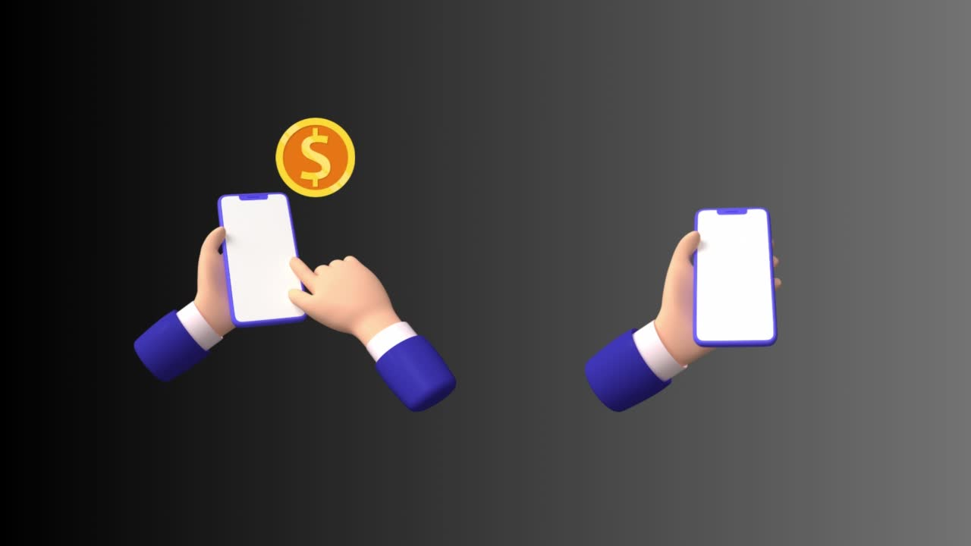
Team : Rizzling Devs
Secure Yourself
with
Domain : Blockchain
ReliefDAO
Problem Statement :
RESILIENT AID: A BLOCKCHAIN SOLUTION FOR SECURE FUND TRANSFERS

Slide 2
ReliefDAO
Secure Yourself
Understanding Our Problem Statement :
RESILIENT AID: A BLOCKCHAIN SOLUTION FOR SECURE FUND TRANSFERS
For victims of war zone
For both residents - Humanitarian
organisation
To facilitate fund transfers
To automate transactions to intended recepients

Slide 3
Secure Yourself
ReliefDAO
Secure Intermediary
User needs no internet
Trusted Contact
Holds tokens on user’s behalf
SOLUTION APPROACH
DAO Facilitation
User empowerment
Global fundraising

Slide 4
Secure Yourself
ReliefDAO
Secure Intermediary
User needs no internet
Holds tokens on user’s behalf
Trusted Contact
Trusted contact transfers funds
SOLUTION APPROACH
DAO Facilitation
Exchanges tokens for equivalent funds
User empowerment
Global fundraising

Slide 5
Secure Intermediary
Secure Yourself
ReliefDAO
User needs no internet
Holds tokens on user’s behalf
Trusted Contact
Trusted contact transfers funds
SOLUTION APPROACH
DAO Facilitation
Exchanges tokens for equivalent funds
User empowerment
Global fundraising
User gets back the unused
tokens in DAO contract

Slide 6
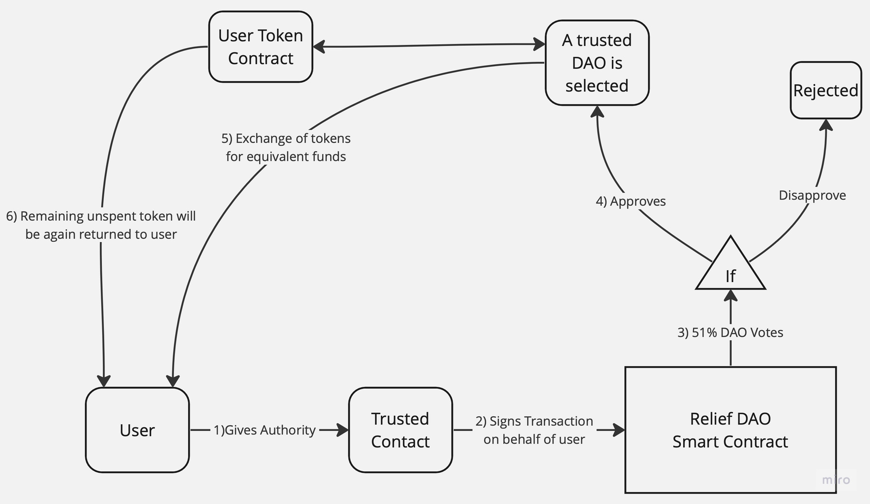
Secure Yourself
ReliefDAO
Process Flow

Slide 7

Secure Yourself
ReliefDAO
Use Cases
Conflict Zones and
War-Torn Regions
Natural Disaster
Supporting
Vulnerable
Populations
Long-Term Financial
Planning
Global Fundraising
Campaigns
Users in conflict
zones can secure funds ensuring access to financial resources.
Refugees, displaced persons (IDPs), and marginalised communities receive targeted assistance with trusted contacts
Humanitarian organizations and NGO’s can efficiently disburse funds to beneficiaries
Not only for crisis situations but also for long-term financial planning, savings, and investments.

Slide 8
ReliefDAO
Secure Yourself
Rizzling Devs
Group No. 32
Group Leader : Abhishek Yadav
Members : Swayam Karle
Vivek Sahu
Anuradha Naidu

